Slide 1
Take The Cue
Autonomous pool playing robot

Slide 2
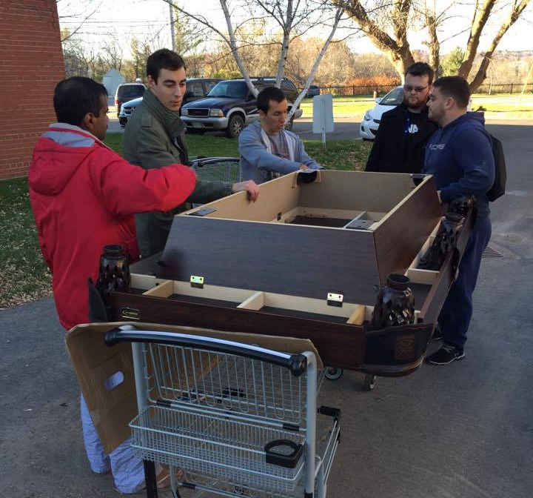
Our Team
Hardware Team
Guy and Ernest
Electrical and Controls Team
Andrew and Derek
Software Team
Eric and Max

Slide 3
Everyone needs a pool partner!
Most existing solutions are prototypes
Too expensive
Too complex to operate
Our solution allows pool players to enjoy their table at all times
Customizable to many table sizes
Easy-To-Use Android module for Visual Recognition
Cost effective ( < $750 )

Slide 4

Project Summary
Autonomous solution for a pool playing partner
Visual Recognition to make its own decisions
Renders image and detects location of balls
Runs simulation to find best shot
Moves actuator to strike the white ball

Slide 5
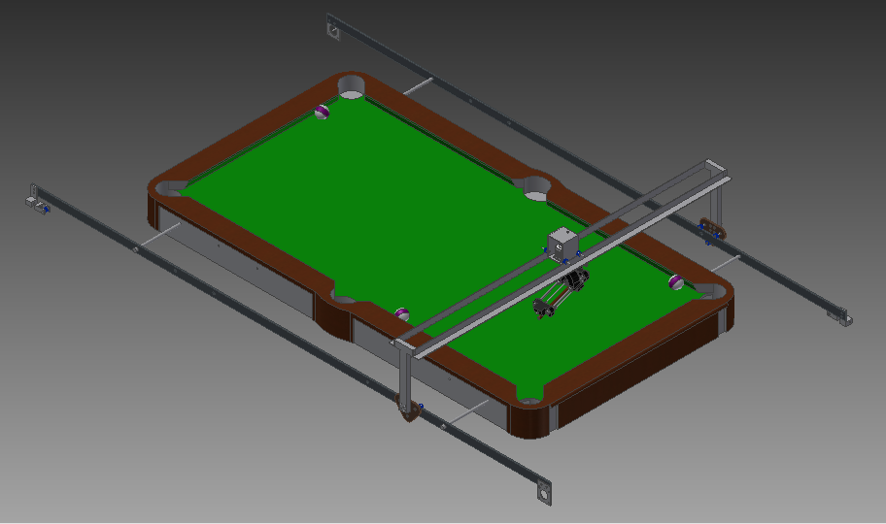
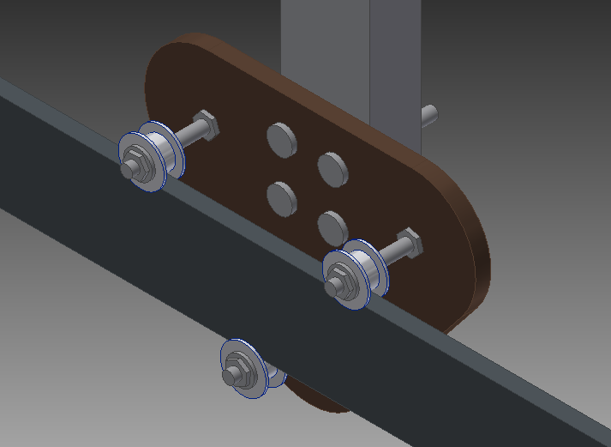
Hardware Summary
X Rails work synchronously
Y Rail is as low as possible
Actuator Strikes ball with varying force
3 motions combine to align Actuator
X, Y and θ
X Rail
Y Rail
Arm Base
End Effector/Actuator

Slide 6
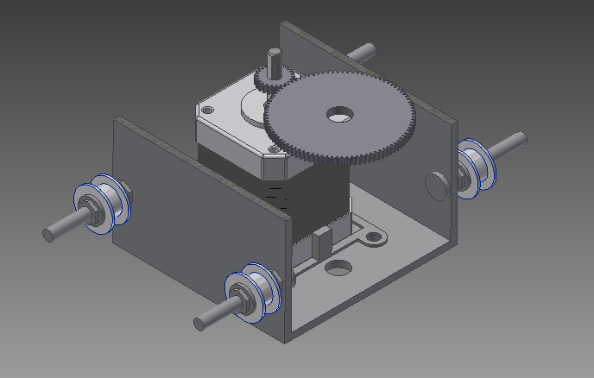
Rotating Mechanism
Uses NEMA 17 to preform motion
Gear Ratio => 4:1
Uses encoder to detect orientation
Rides two rails for stability
Rotating Mechanism

Slide 7
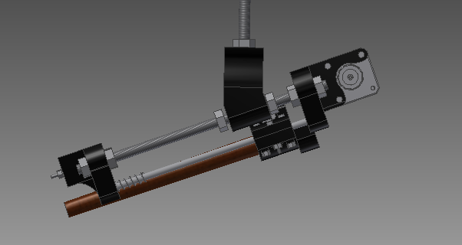
Hardware Hurdles
Hit balls while still moving around easily
Actuator tilted 20 degrees
Reaching the whole table
Move rails further out
Strike a ball with sufficient force
Electrical Motor or Pneumatics
Actuator

Slide 8
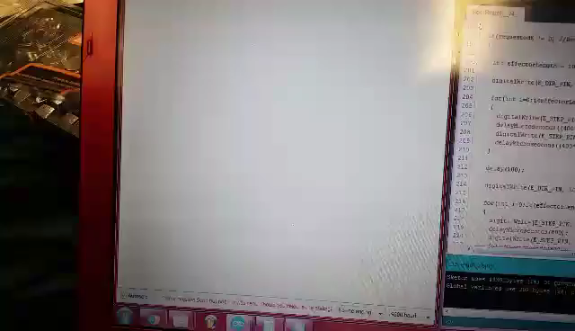
Hardware Demo – Shooting Mechanism

Slide 9
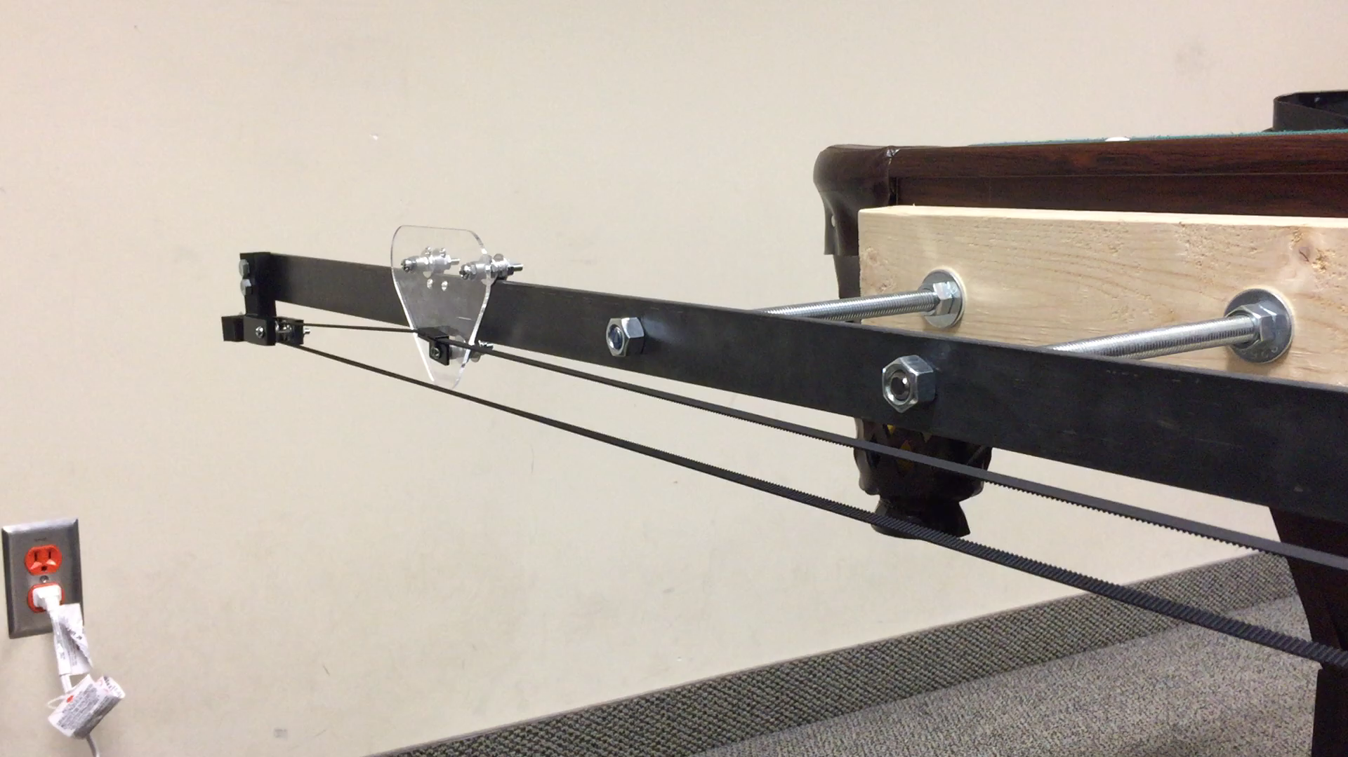
Hardware Demo – X Rails

Slide 10
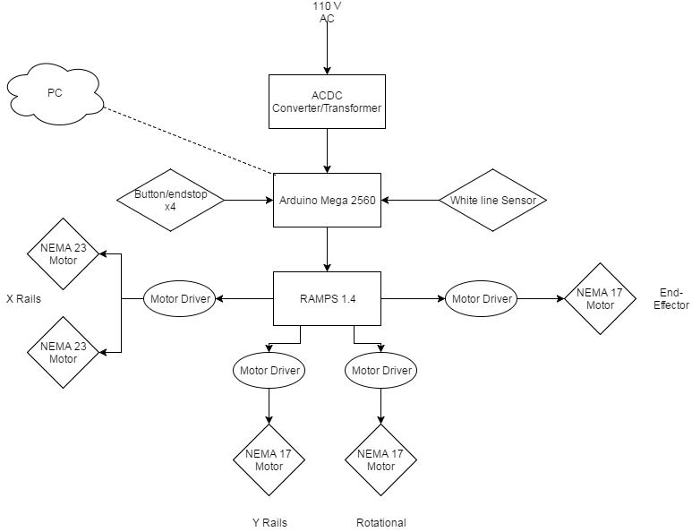
Electrical and Controls Summary
RAMPS 1.4 simplifies design with modular motor drivers
Buttons/endstops for controlling motors within bounds
White line sensors for keeping track of rotational position

Slide 11
Electrical and Controls Hurdles
One X-rail motor lags behind the other
Solution: control both motors from the same motor driver
Finding number of steps the motors can traverse along x and y axis
Solution: write program that counts steps and moves system from one end of the table to the other and stops when button/endstop is triggered
User not knowing the current mode the system is in
Solution: colour changing LED changes colours according to mode of the system

Slide 12


Software Summary
Arduino program:
Receives user commands
Monitors sensor signals
Controls motors
Serial communication with PC
Android program:
Automated image capture
Socket communication with PC

Slide 13
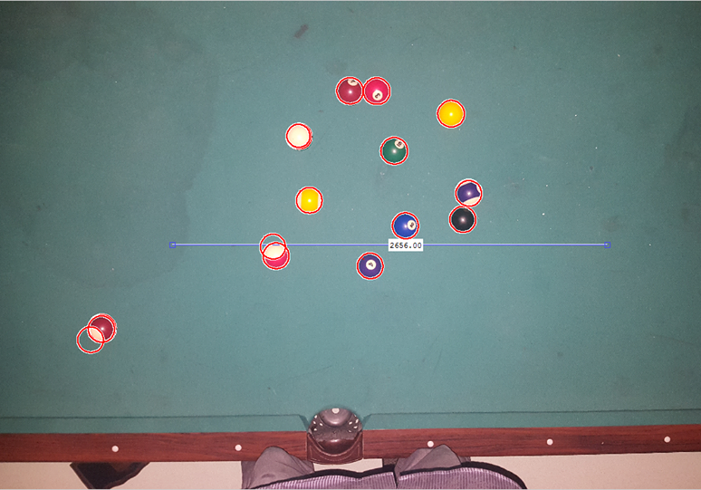
Software Summary (cont.)
Java program:
Various communication
protocols with other programs
Simulates shots to find the
optimal one
Matlab program:
Object detection
Ball identification

Slide 14
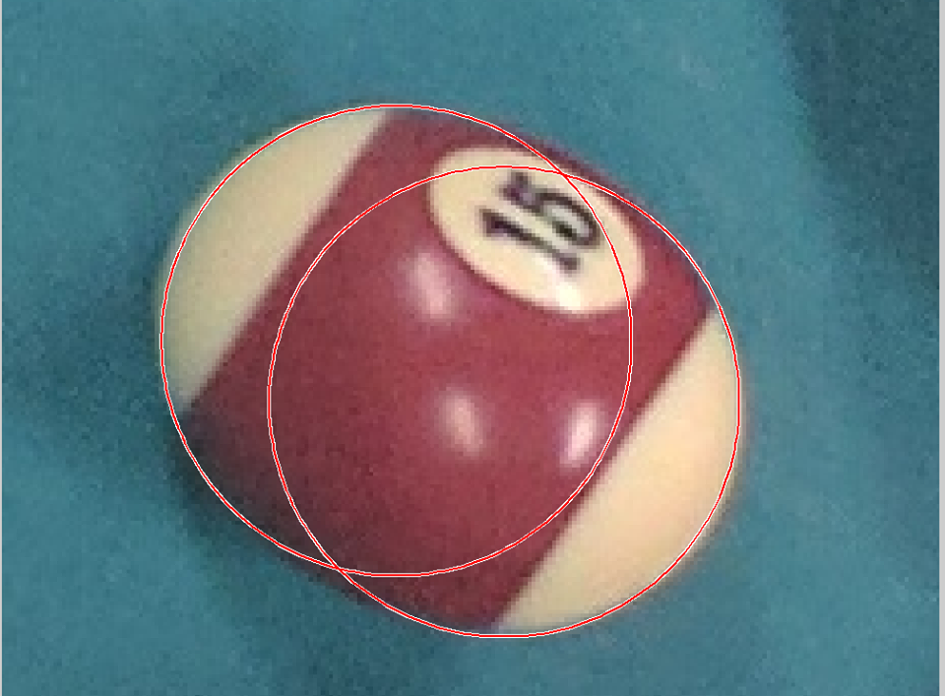

Software Hurdles
Object detection and identification
Relation of simulation to real worlds
Android emulator crashing often
Android uncooperative with
automated image capture

Slide 15
Software Demo

Slide 16

Thank You For Your Time!

